Slide 1


#Hashtags as a Means for Political Action
Exploring the Impact of Location-based Hashtag Activism on Place-Specific Political Processes Using Geolocated Social Media Posts Data
Leonardo Nicoletti

Slide 2
Problem Introduction
#Hashtag Activism today → crucial strategy for activists to influence social change
Lots of research in this field
Importance for the organization and effectiveness of social movements
Importance for influencing political processes
Last summer: #JusticeForGeorgeFloyd
Notes:
Today, # Hashtag Activism, the use of Twitter's hashtags to do activism online → crucial strategy for activists trying to influence social change
Over the past 2 decades there has been a lots of research in this field,
Importance for the organization and effectiveness of social movements
Importance for spreading political ideas
Last year, we’ve all seen how one hashtag, #justiceforgeorgefloyd, has led to millions of people protesting in the US and worldwide and challenge the very existence of a long time institution (police)

Slide 3
Knowledge Gap
Lack of research regarding the geographical characteristics of social media movements
Unresolved questions:
is Twitter activity in a specific area more likely to influence political processes within that same area?
can the location from where people tweet determine the location from where change happens?
Notes:
Because location data from social media is hard to get, there is a lack of research regarding the geographical characteristics of social media movements and the role of space in determining the outcomes of these movements
Scholars who study social movements agree that the geographical characteristics are important but have not answered simple questions such as:
is twitter activity in a specific area more likely to influence political processes within that same area?
can the location from where activists tweet determine the location from where change happens?

Slide 4
Knowledge Gap
Lack of research regarding the geographical characteristics of social media movements
Unresolved questions:
is twitter activity in a specific area more likely to influence political processes within that same area?
can the location from where people tweet determine the location from where change happens?
→ the relationship between location based hashtag activism and location based political processes (e.g. voter behaviour, policy adoption)
Notes:
More specifically, a thorough understanding of the relationship b/w location based hashtag activism and location based political processes (such as voter behaviour, policy adoption) is lacking

Slide 5
Research Question
How can location-based hashtag activism influence place-specific political processes in the United States?
Notes:
This master thesis aims to investigate this relationship and hopefully answer the following question: How can location-based hashtag activism influence place-specific political processes in the United States?

Slide 6
Research Framework
SQ. Who are the key actors involved in location-based hashtag activism for driving political processes?
Political processes
Legislative responses
Social Movements
Physical protest
SQ. How does location-based hashtag activism translate into physical protest activity?
Hashtag Activism
SQ. How does location-based hashtag activism influence voter behaviour and policy adoption?
Key Actors
Notes:
In order to design this research, I’ve broken it up into different subquestions
First, seeing as physical protest has often been an enabler for social change, I will look at how does location-based hashtag activism translate into physical protest activity

Slide 7
Research Framework
SQ. Who are the key actors involved in location-based hashtag activism for driving political processes?
Political processes
Policy adoption
Voter behaviour
Physical protest
SQ. How does location-based hashtag activism translate into physical protest activity?
Hashtag Activism
SQ. How does location-based hashtag activism influence voter behaviour and policy adoption?
Key Actors
Notes:
In order to design this research, I’ve broken it up into different subquestions
First, seeing as physical protest has often been an enabler for social change, I will look at how does location-based hashtag activism translate into physical protest activity

Slide 8
Research Framework
SQ. Who are the key actors involved in location-based hashtag activism for driving political processes?
Political processes
Policy adoption
Voter behaviour
Physical protest
SQ. How does location-based hashtag activism translate into physical protest activity?
Hashtag Activism
SQ. How does location-based hashtag activism influence voter behaviour and policy adoption?
Key Actors
Notes:
Second, two very concrete political processes are 1) voter behaviour and 2) policy adoption. So, another section of this research aims to investigate how does location-based hashtag activism influence voter behaviour and/or policy adoption?

Slide 9
Research Framework
SQ. Who are the key actors involved in location-based hashtag activism for driving political processes?
Political processes
Policy adoption
Voter behaviour
Physical protest
SQ. How does location-based hashtag activism translate into physical protest activity?
Hashtag Activism
SQ. How does location-based hashtag activism influence voter behaviour and policy adoption?
Key Actors
Notes:
Finally, I will look at who are the key actors involved in location-based hashtag activism for driving political processes? Network + demographic perspective
Which actors hold the most social influence over the general network of protest
are there specific socio-demographic groups that engage in hashtag activism more than others?

Slide 10
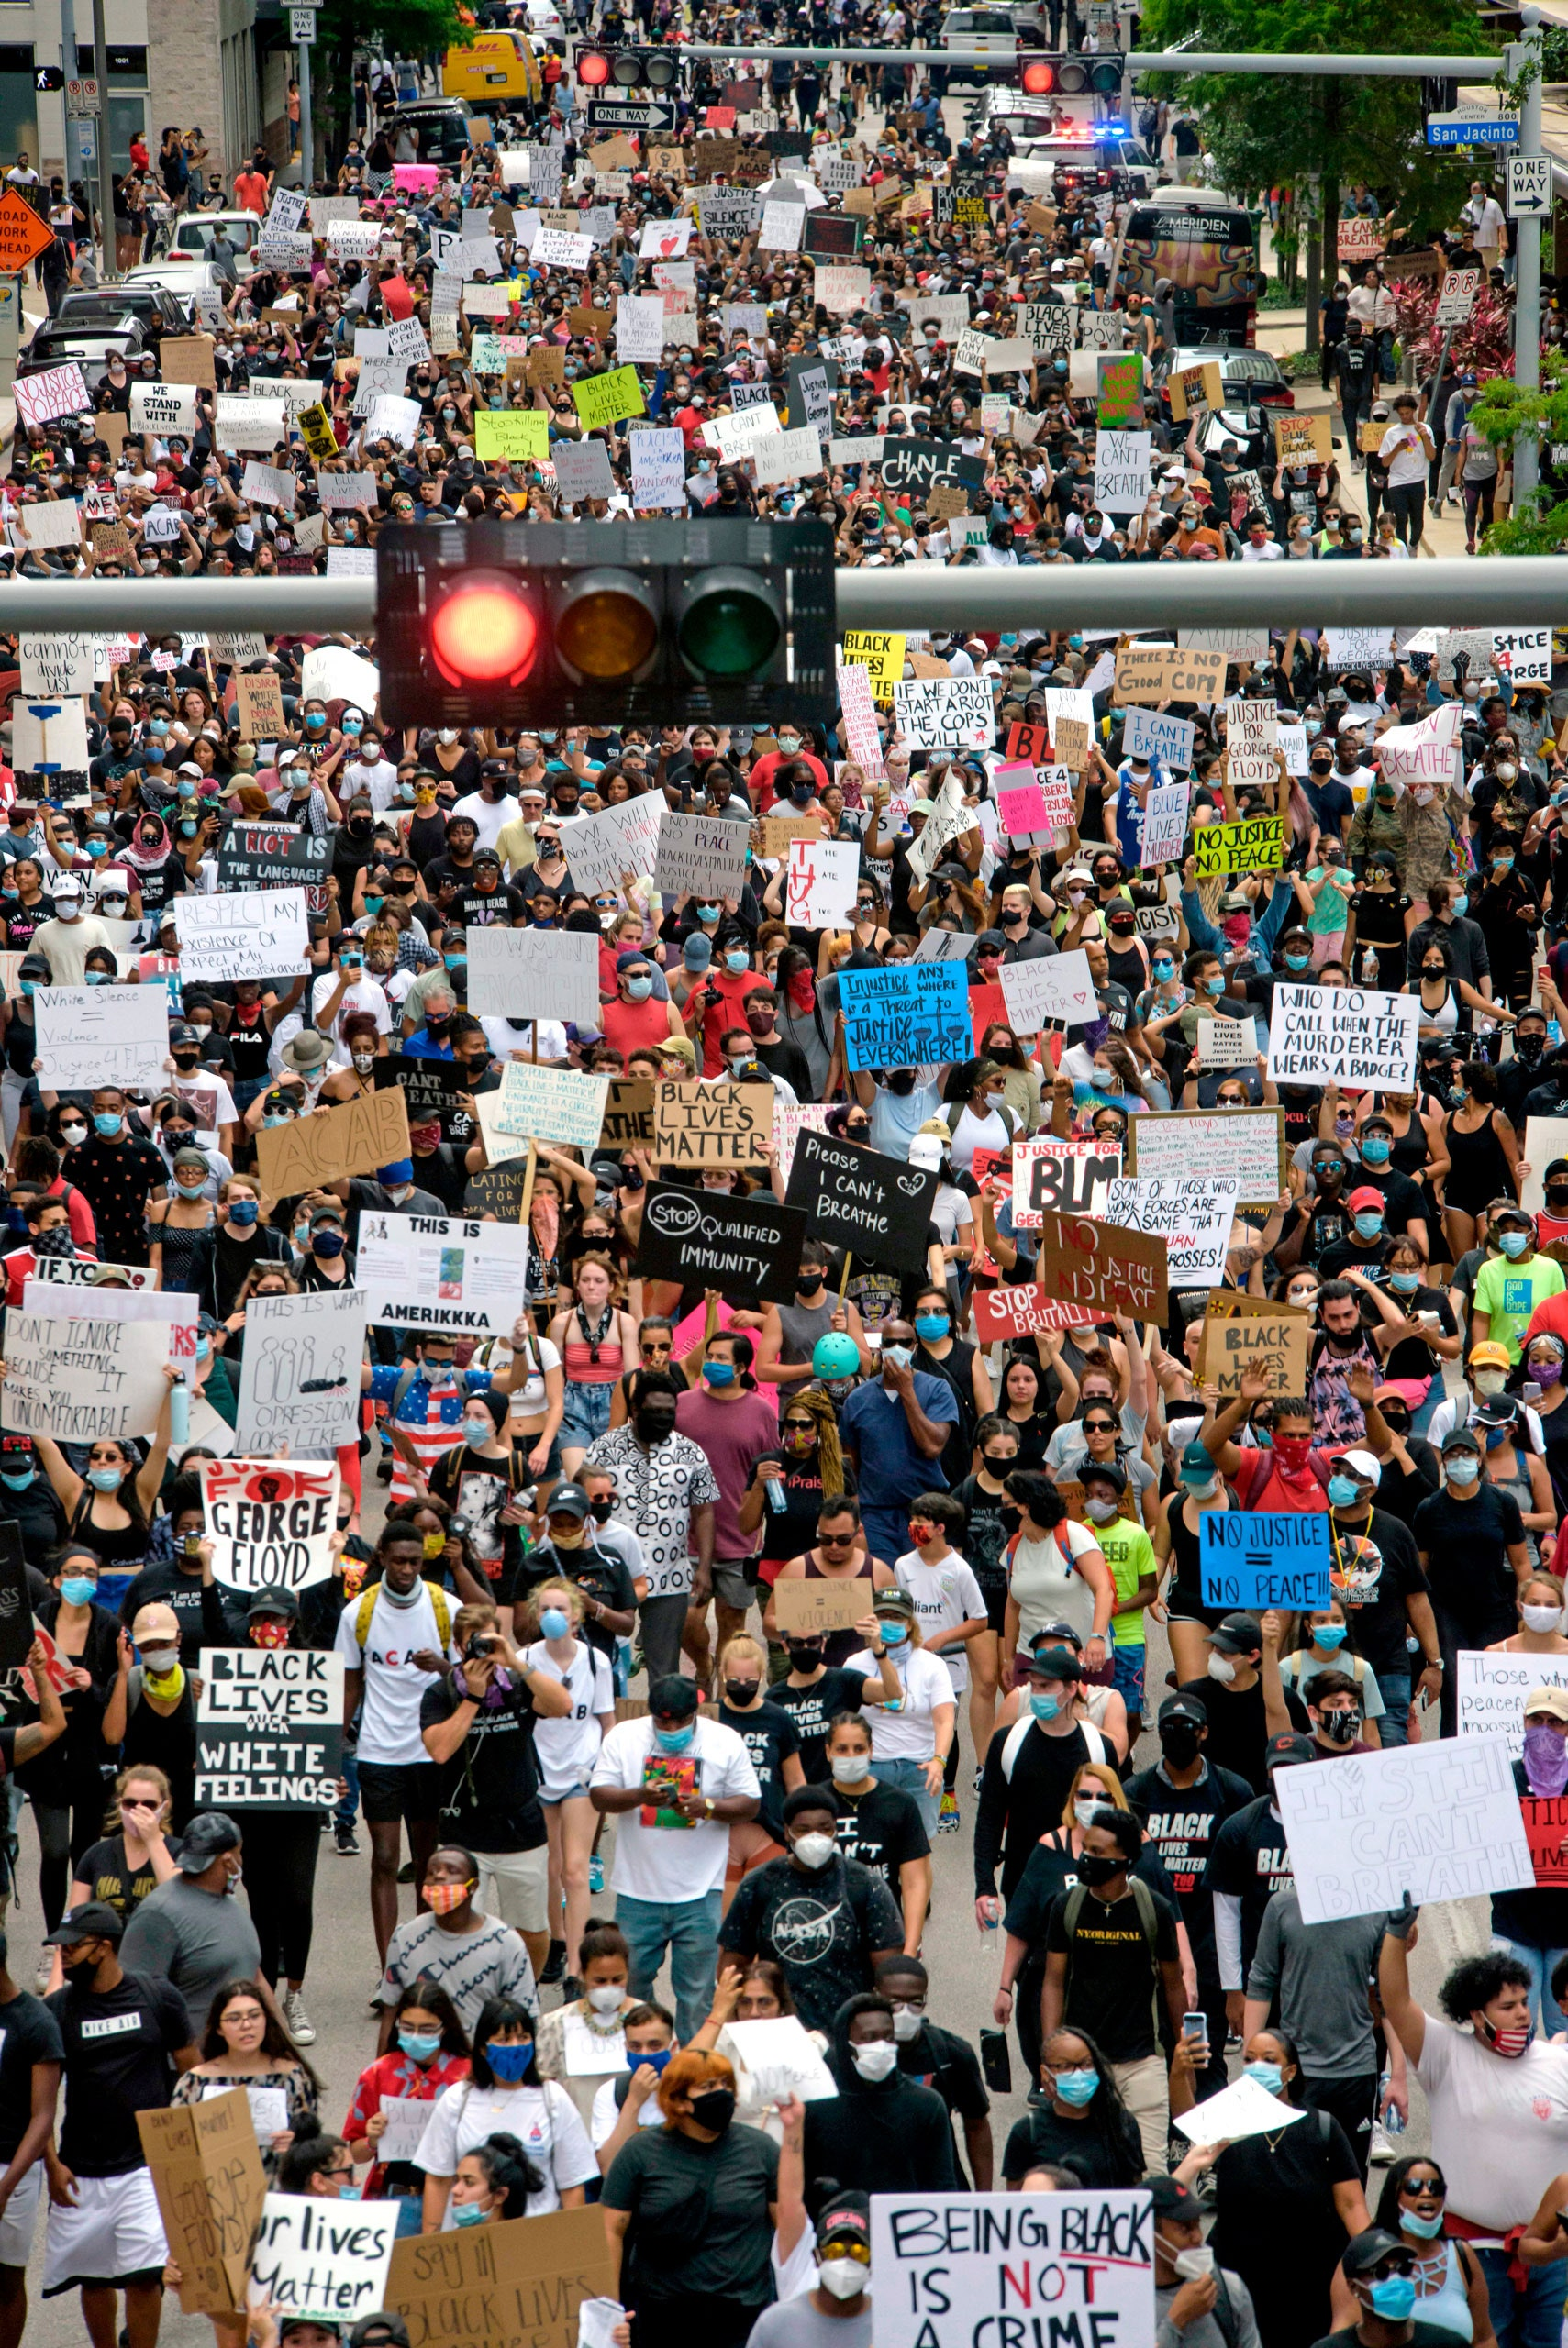
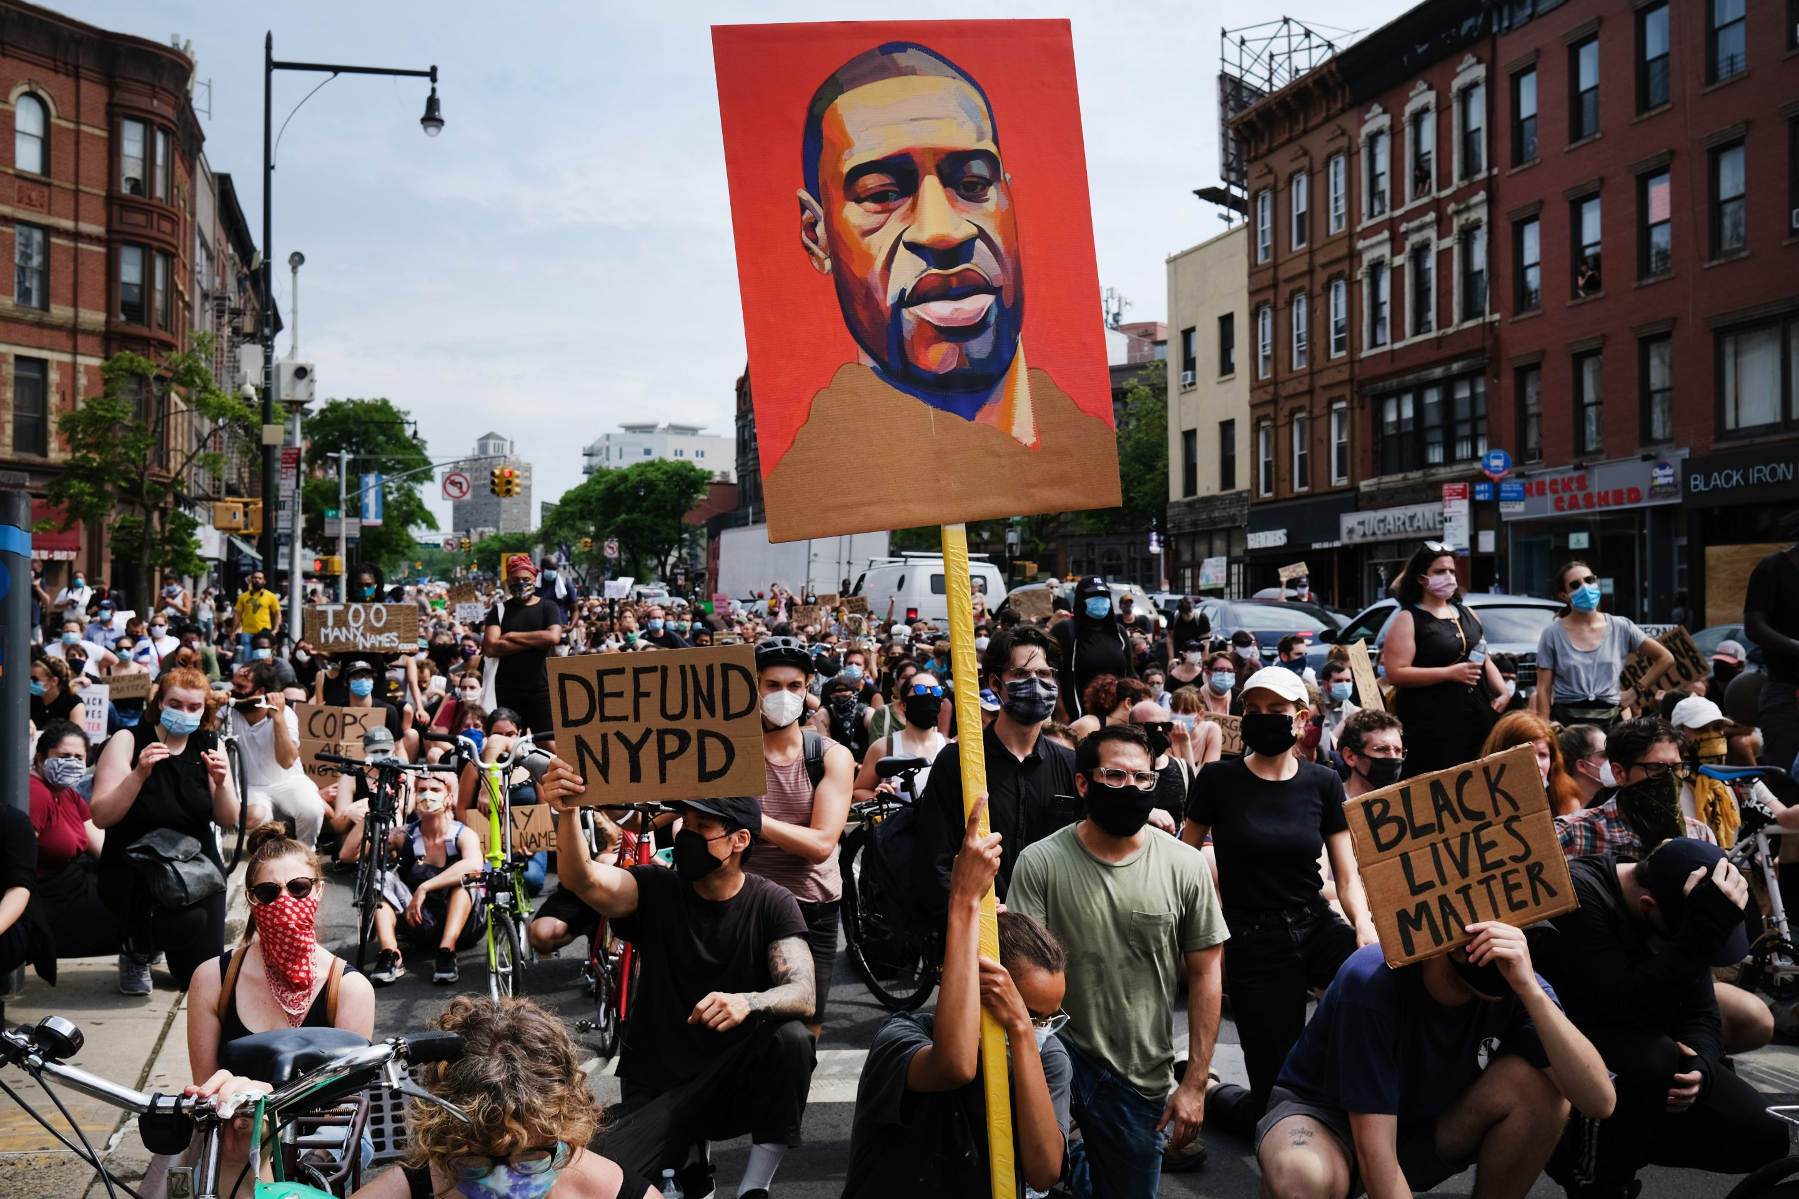
Methods
Case study of Justice For George Floyd
5 data-sets
geo-located Twitter data from Twitter API
geo-located protest data from ACLED
data on legislatives responses to policing from NCSL
data on 2016/2020 county/precinct level election results
2020 census demographic data
Data Science approach
Web scraping
Geospatial data analysis
Network Analysis
ML (classification, regression, clustering)
Notes:
How am I doing this?
I am using the social media movement #JusticeForGeorgeFloyd of last summer as a case study to drive this research

Slide 11

Methods
Case study of Justice For George Floyd
5 data-sets
1M geo-located tweets data from Twitter API
geo-located protest data from ACLED
data on legislatives responses to policing from NCSL
data on 2016/2020 county/precinct level election results
2020 census demographic data
Data Science approach
Web scraping
Geospatial data analysis
Network Analysis
ML (classification, regression, clustering)
Notes:
I am use 5 primary data-sets
1M geo-located tweets data from Twitter API
geo-located protest data from ACLED (the Armed Conflict Location & Event Data Project)
data on legislatives responses to policing from NCSL (National Council for State Legislatures)→ currently trying to find a more granular dataset
data on 2016/2020 county/precinct level election results
2020 census demographic data

Slide 12
Methods
Case study of Justice For George Floyd
5 data-sets
1M geo-located tweets data from Twitter API
geo-located protest data from ACLED
data on legislatives responses to policing from NCSL
data on 2016/2020 county/precinct level election results
2020 census demographic data
Data Science approach
Web scraping
Geospatial data analysis
Network Analysis
ML (classification, regression, clustering)
Notes:
Finally I am using a Data Science approach for this research:

Slide 13
Methods
Case study of Justice For George Floyd
5 data-sets
1M geo-located tweets data from Twitter API
geo-located protest data from ACLED
data on legislatives responses to policing from NCSL
data on 2016/2020 county/precinct level election results
2020 census demographic data
Data Science approach
Web scraping
Geospatial data analysis
Network Analysis
ML (classification, regression, clustering)
iterative process
Notes:
As an iterative process

Slide 14
Political processes
SQ. Who are the key actors involved in location-based hashtag activism for driving political processes?
How can location-based hashtag activism influence place-specific political processes in the United States?
SQ. How does location-based hashtag activism translate into physical protest activity?
Policy adoption
Voter behaviour
Physical protest
Hashtag Activism
SQ. How does location-based hashtag activism influence voter behaviour and policy adoption?
Key Actors
Notes:
Ok so, we are now back to our research framework and I would now like to share the main results I have obtained so far for each section

Slide 15
Political processes
How can location-based hashtag activism influence place-specific political processes in the United States?
SQ. How does location-based hashtag activism translate into physical protest activity?
Physical protest
Hashtag Activism
Notes:
Let’s focus on the first subquestion: how does location based #activism translate into physical protest activity?

Slide 16
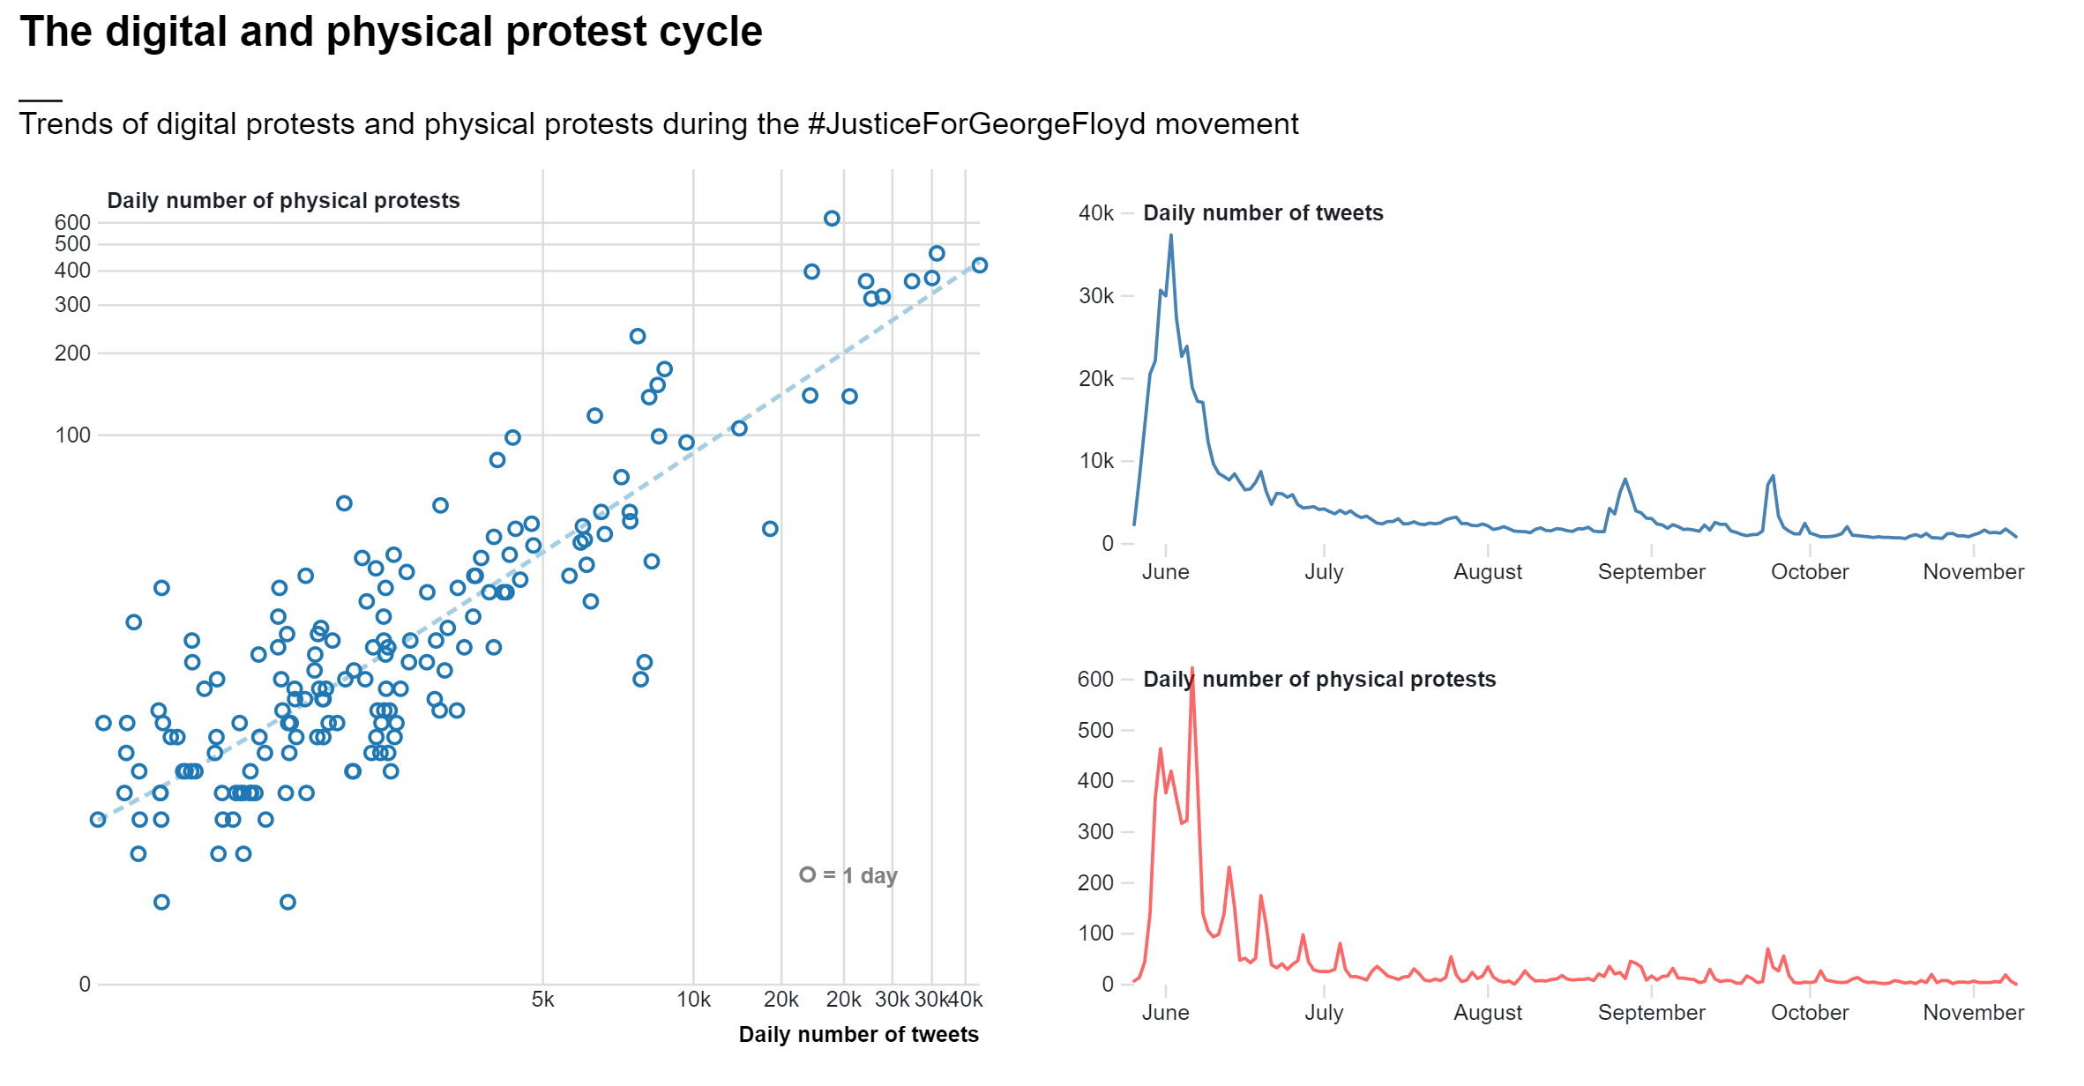
Notes:
In this slide you can see two charts:
On your left you have a scatterplot illustrating the relationship between daily number of physical protests and daily number of tweets
As we can see physical and digital protests are very closely related. On days where people protest more on social media, people also protest more in the street, and vice versa. In the case of #JusticeForGeorgeFloyd, people used Twitter to express outrage about events of police brutality and to organize physical protests. During protests, more acts of police brutality were documented and shared on Twitter, which led to yet more protests and to more people showing up to protests, and so on.

Slide 17
+
Digital Protest
Physical Protest
+
Notes:
This trend illustrates an intuitive cycle, where digital protest and physical protest interact together and amplify one-another.

Slide 18
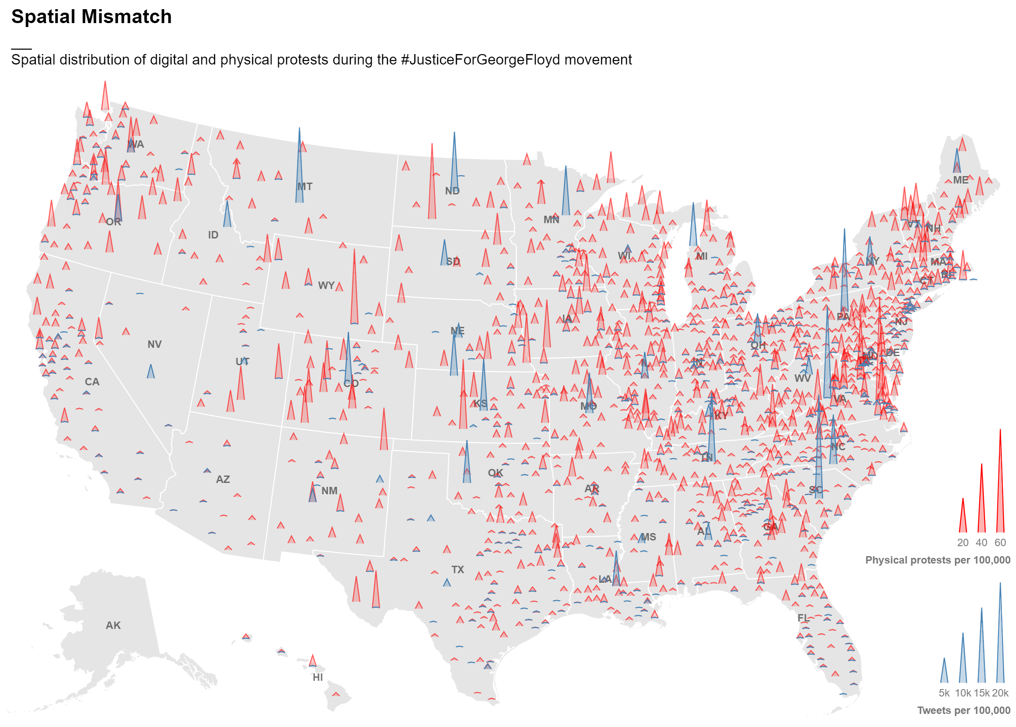
Notes:
With such a clear trend, one would expect that digital and physical protests happen in the same location. But this is not the case, as there is a clear spatial mismatch between the two phenomena: where digital protests abound, few people take the streets, and vice-versa.

Slide 19
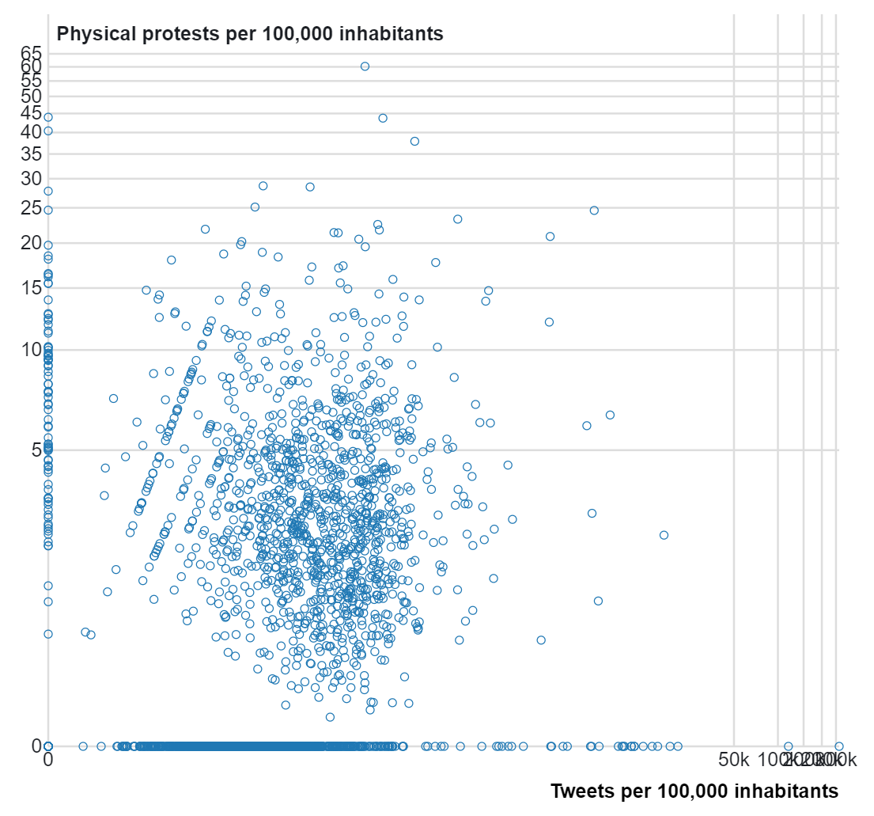
spatial mismatch
digital protest in county x
!=
physical protest in county x
Notes:
In other words, the data suggests that it is unlikely that both physical and digital protests will take place in the same specific location on the same given day. Rather, if on a given day there are more digital protests in a one location, it is likely that there will also be more physical protests in another location.

Slide 20
Political processes
How can location-based hashtag activism influence place-specific political processes in the United States?
SQ. Where does location-based hashtag activism translate into physical protest activity?
Policy adoption
Voter behaviour
Physical protest
Hashtag Activism
SQ. How does location-based hashtag activism influence voter behaviour and policy adoption?
Notes:
Let’s now focus on the second subquestion: How does location-based hashtag activism influence voter behaviour and policy adoption?

Slide 21
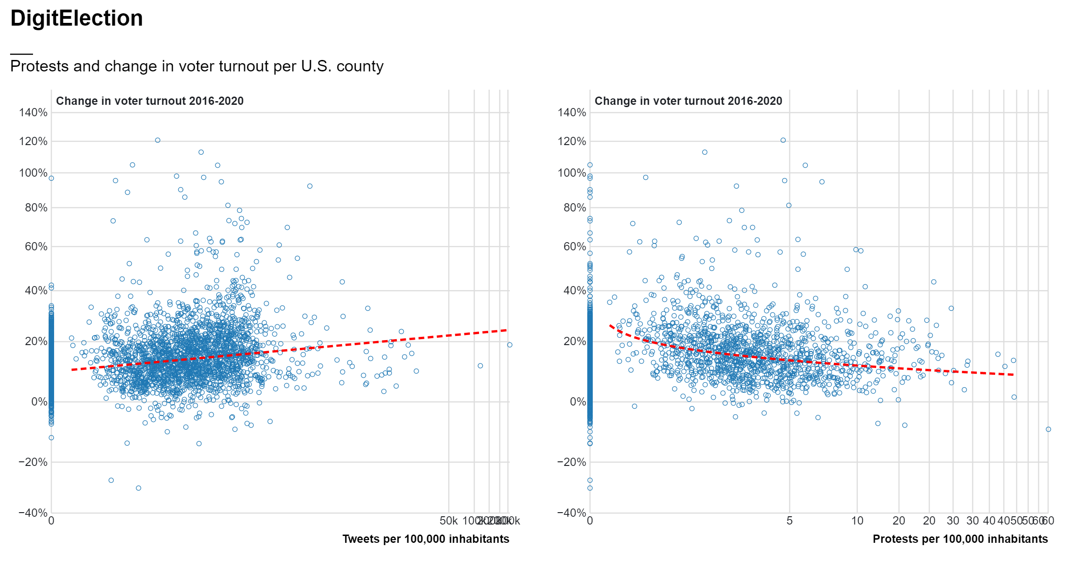
Notes:
On this graph you can see …
Although the data is majorly skewed by outliers, we can observe a positive trend between the number of tweets per 100,000 inhabitants and the change in voter turnout between 2016 and 2020

Slide 22
Notes:
On this graph you can see…
Contrary to digital protests, physical protest show a negative correlation with change in voter turnout

Slide 23
digital protest in place x
=
greater increase in voter turnout in place x
physical protest in place x
=
smaller increase in voter turnout in place x
Notes:
What this data indicates is that in places where people protested more on twitter, voter turnout increased more since 2016, whereas in places where people protested more in the street, voter turnout increased less since 2016

Slide 24
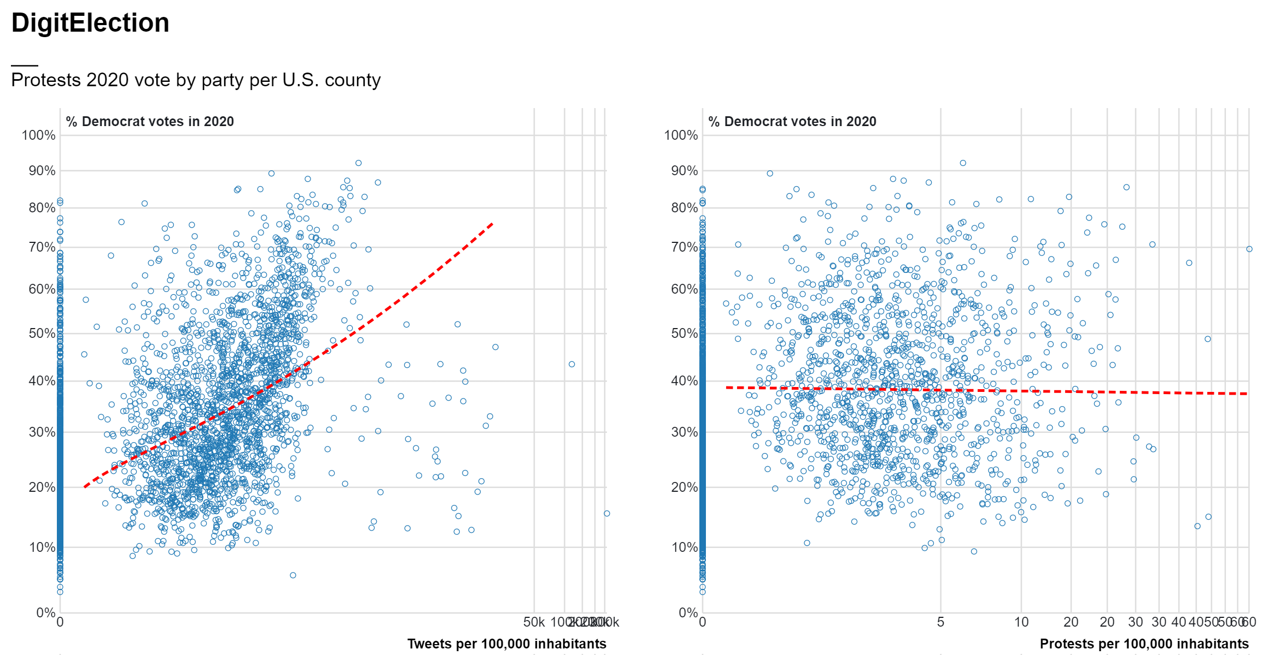
Notes:
Similarly let’s now look at the relationship between democratic voter turnout and both digital and physical protests
In this graph you can see…
Again we observe a positive trend between the number of tweets per 100,000 inhabitants and the percentage of democratic votes within a county during the 2020 presidential elections

Slide 25
Notes:
Physical protest, however, bares no trend with democratic votes

Slide 26
digital protest in place x
=
more democratic votes in place x
physical protest in place x
=
? democratic votes in place x
Notes:
→ in places where, in places where people protested more on twitter the proportion of democratic votes during the 2020 election was higher, whereas in places where people protested more in the street the proportion of democratic votes was quite variable and random

Slide 27
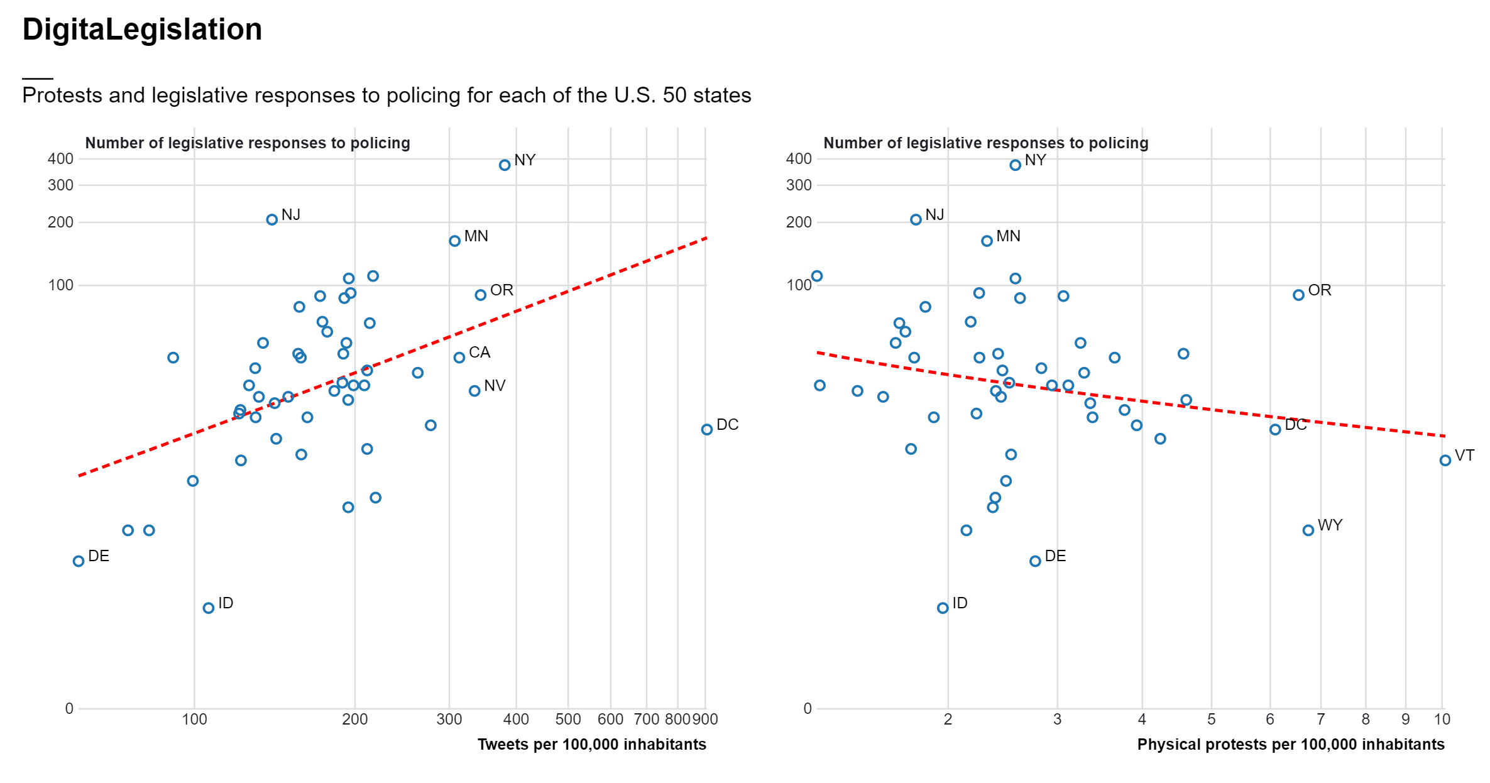
Notes:
Finally, and perhaps most striking, let’s look at the relationship between legislative responses to police brutality and both digital and physical protests.
In this graph you can see…
Here the story is very much consistent with what we have previously observed: we observe a positive trend between the number of tweets per 100,000 inhabitants in a given place and the number of legislative responses to policing in that place

Slide 28
Notes:
on the other hand, physical protests bear no (or even opposite) relationship with subsequent state-level legislative change

Slide 29
digital protest in place x
=
more legislative responses in place x
physical protest in place x
=
less legislative responses in place x
Notes:
So, while more digital protest in one place is an indication of more legislative responses, more physical protests in one place is an indication of less legislative responses

Slide 30
Political processes
SQ. Who are the key actors involved in location-based hashtag activism for driving political processes?
How can location-based hashtag activism influence place-specific political processes in the United States?
SQ. How does location-based hashtag activism translate into physical protest activity?
Policy adoption
Voter behaviour
Physical protest
Hashtag Activism
SQ. How does location-based hashtag activism influence voter behaviour and policy adoption?
Key Actors
Notes:
Let’s now focus on the third and final subquestion: Who are the key actors involved in location-based hashtag activism for driving political processes?
This section of my research is still very much in an exploratory phase, but I have made some initial steps in (I hope) the right direction

Slide 31
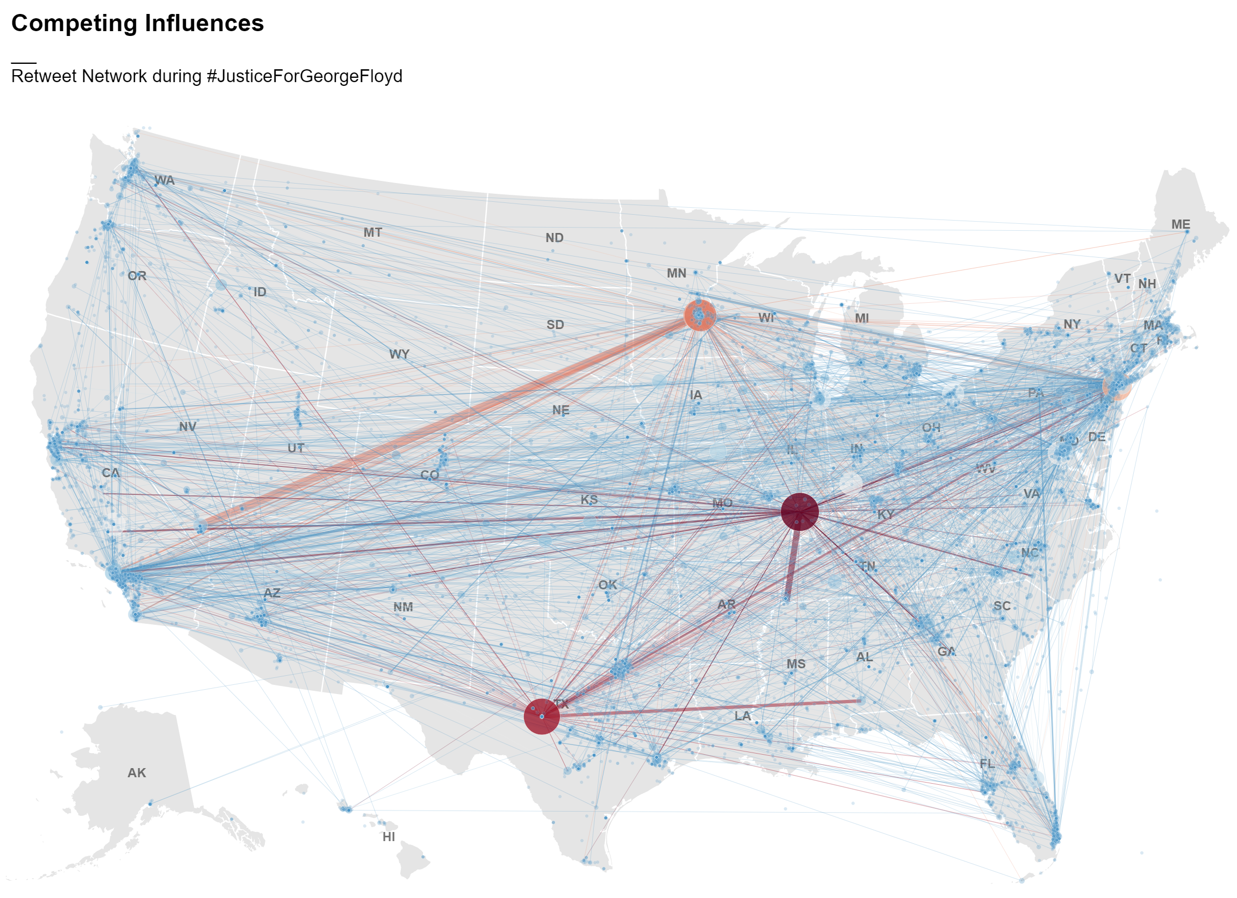
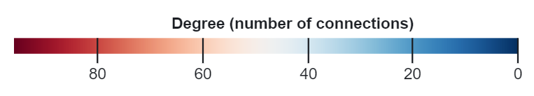
Notes:
In this slide you can see the social network from the #JusticeForGeorgeFloyd movement from May to November 2020, mapped in space. Where:
Each node/circle represents a user
Each link represents a connections between two users by means of retweet
The size and color of a node represents its degree, or the number of users it is connected to
The thickness of a link represents the strength of the connection between two users, or the number of times a user was retweeted by the same user
I have made an interactive visualization of this, which has proven very useful to get some initial insight into sources of influence during the case of #JusticeForGeorgeFloyd, in terms of:
who the most influential actors are
from what geographical locations are these actors excercing their influence
and finally, which geographical locations are these actors reaching through their social influence

Slide 32
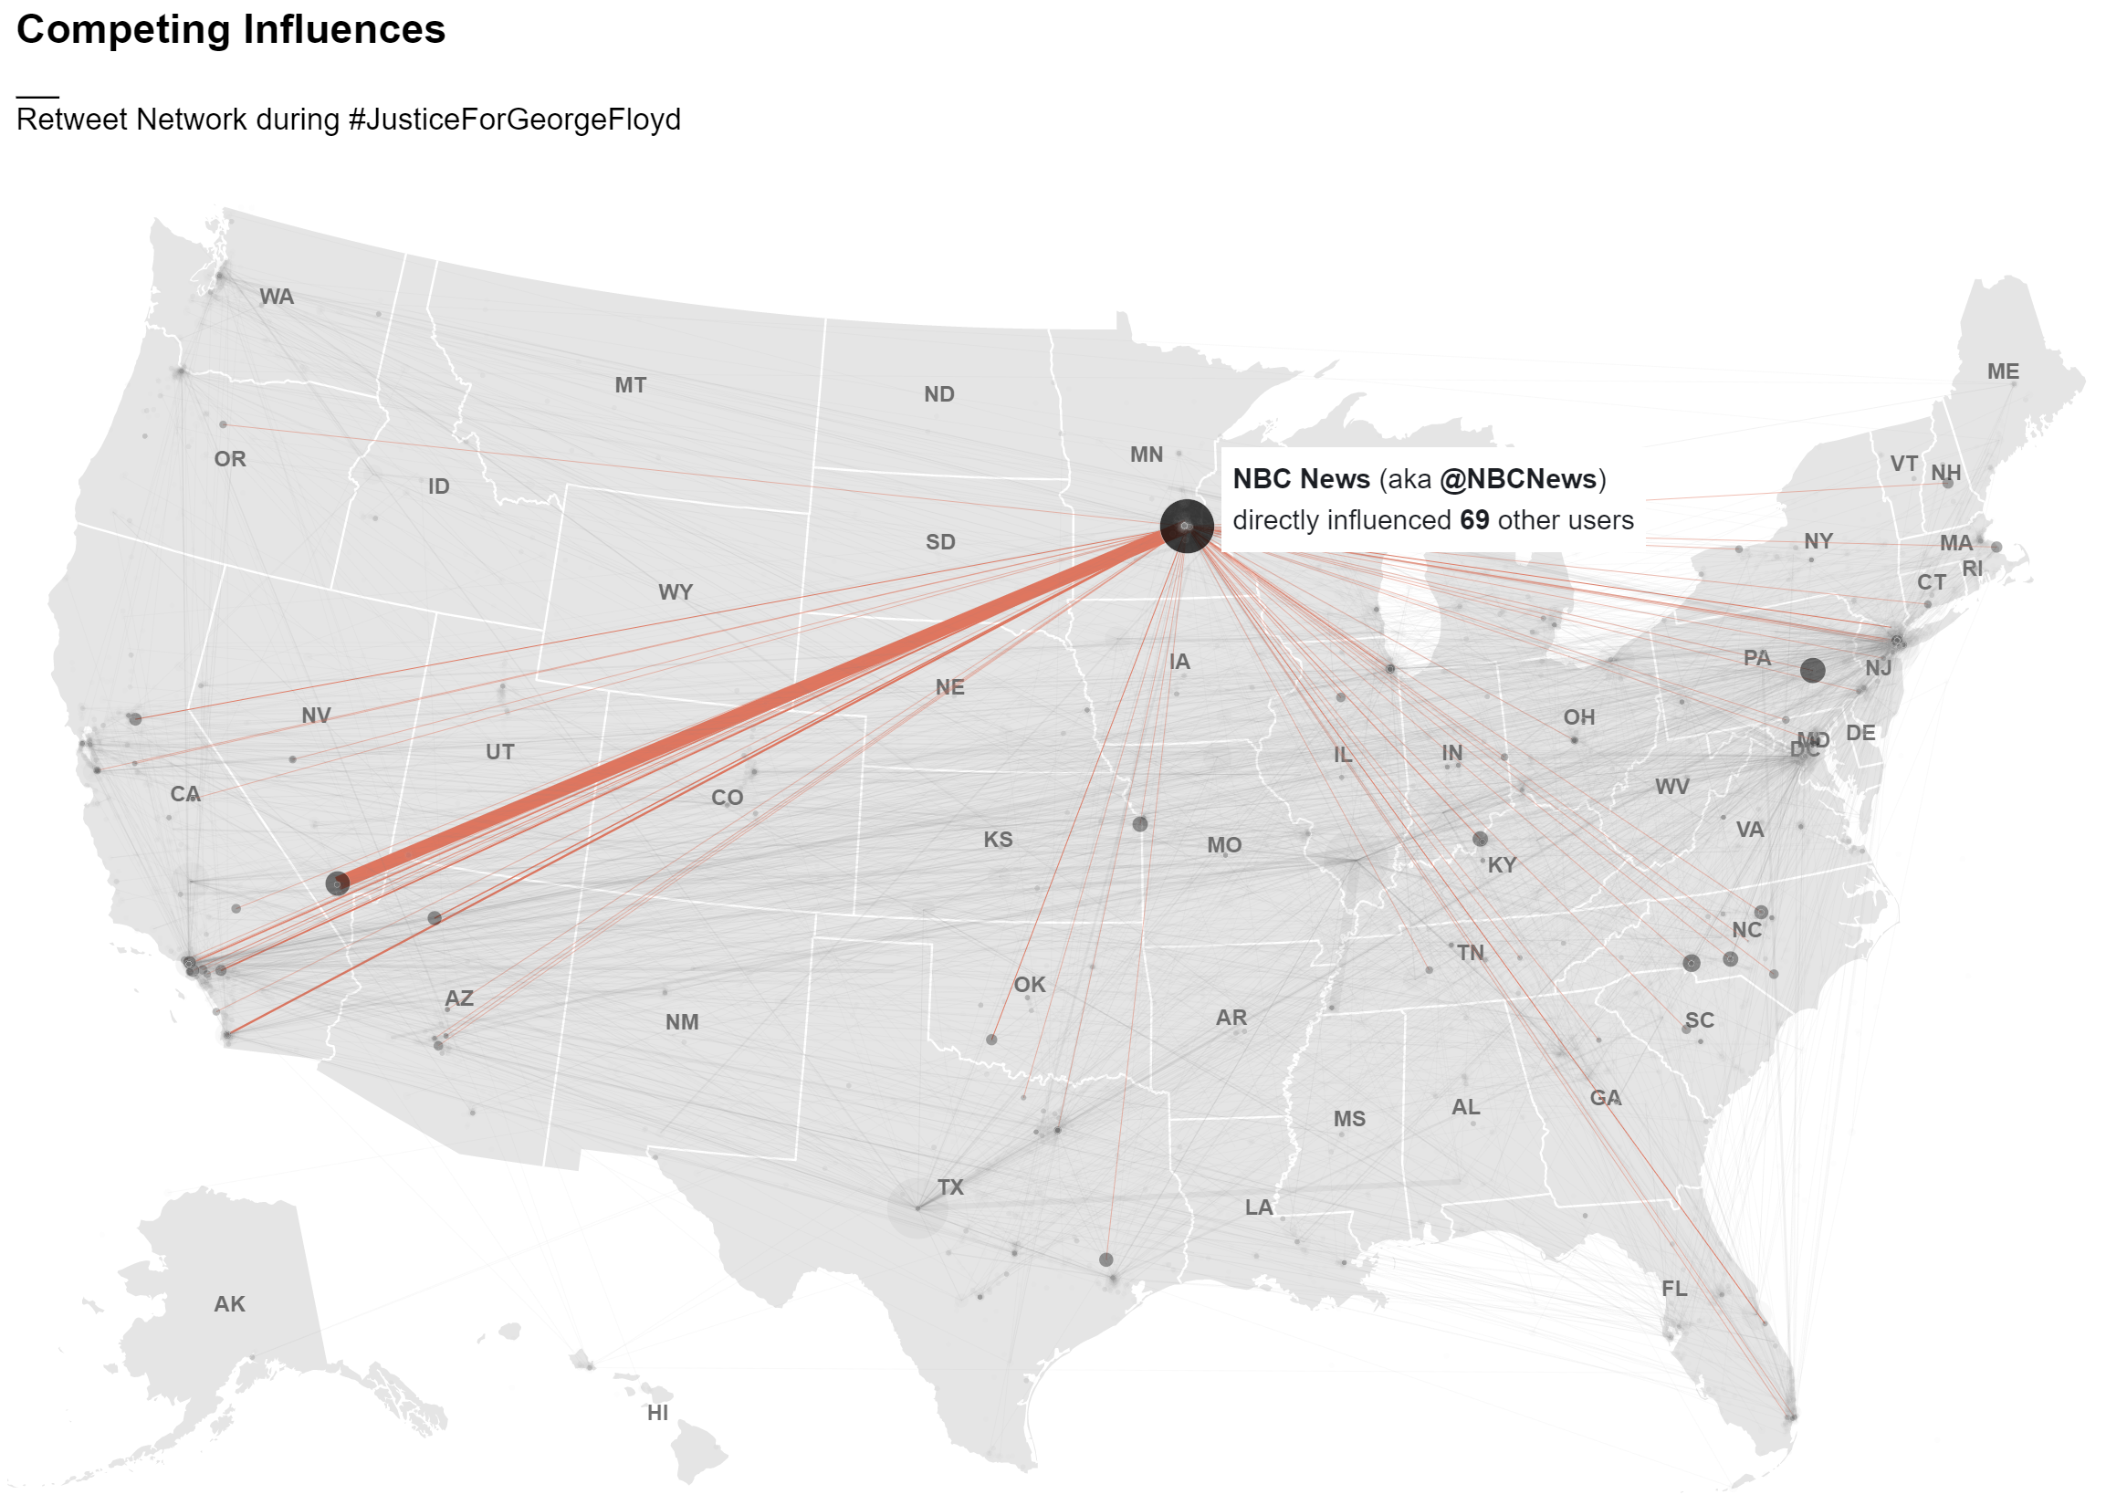

Slide 33
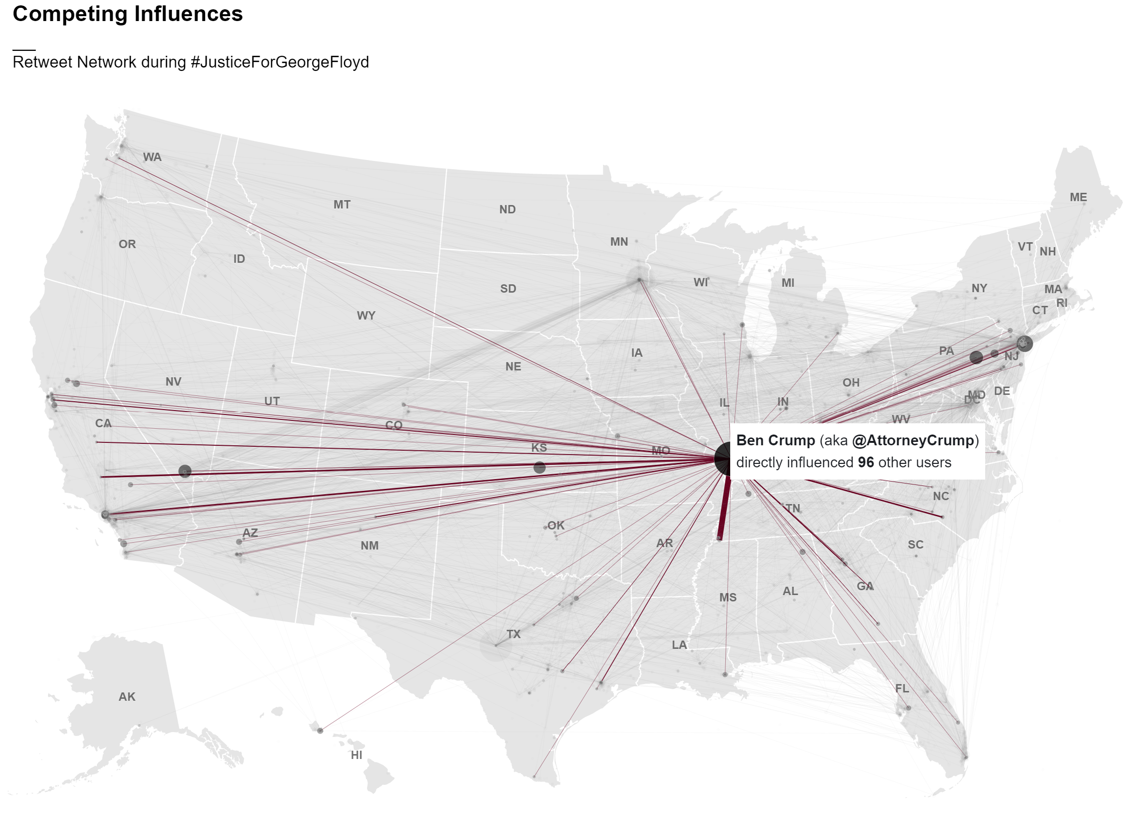

Slide 34
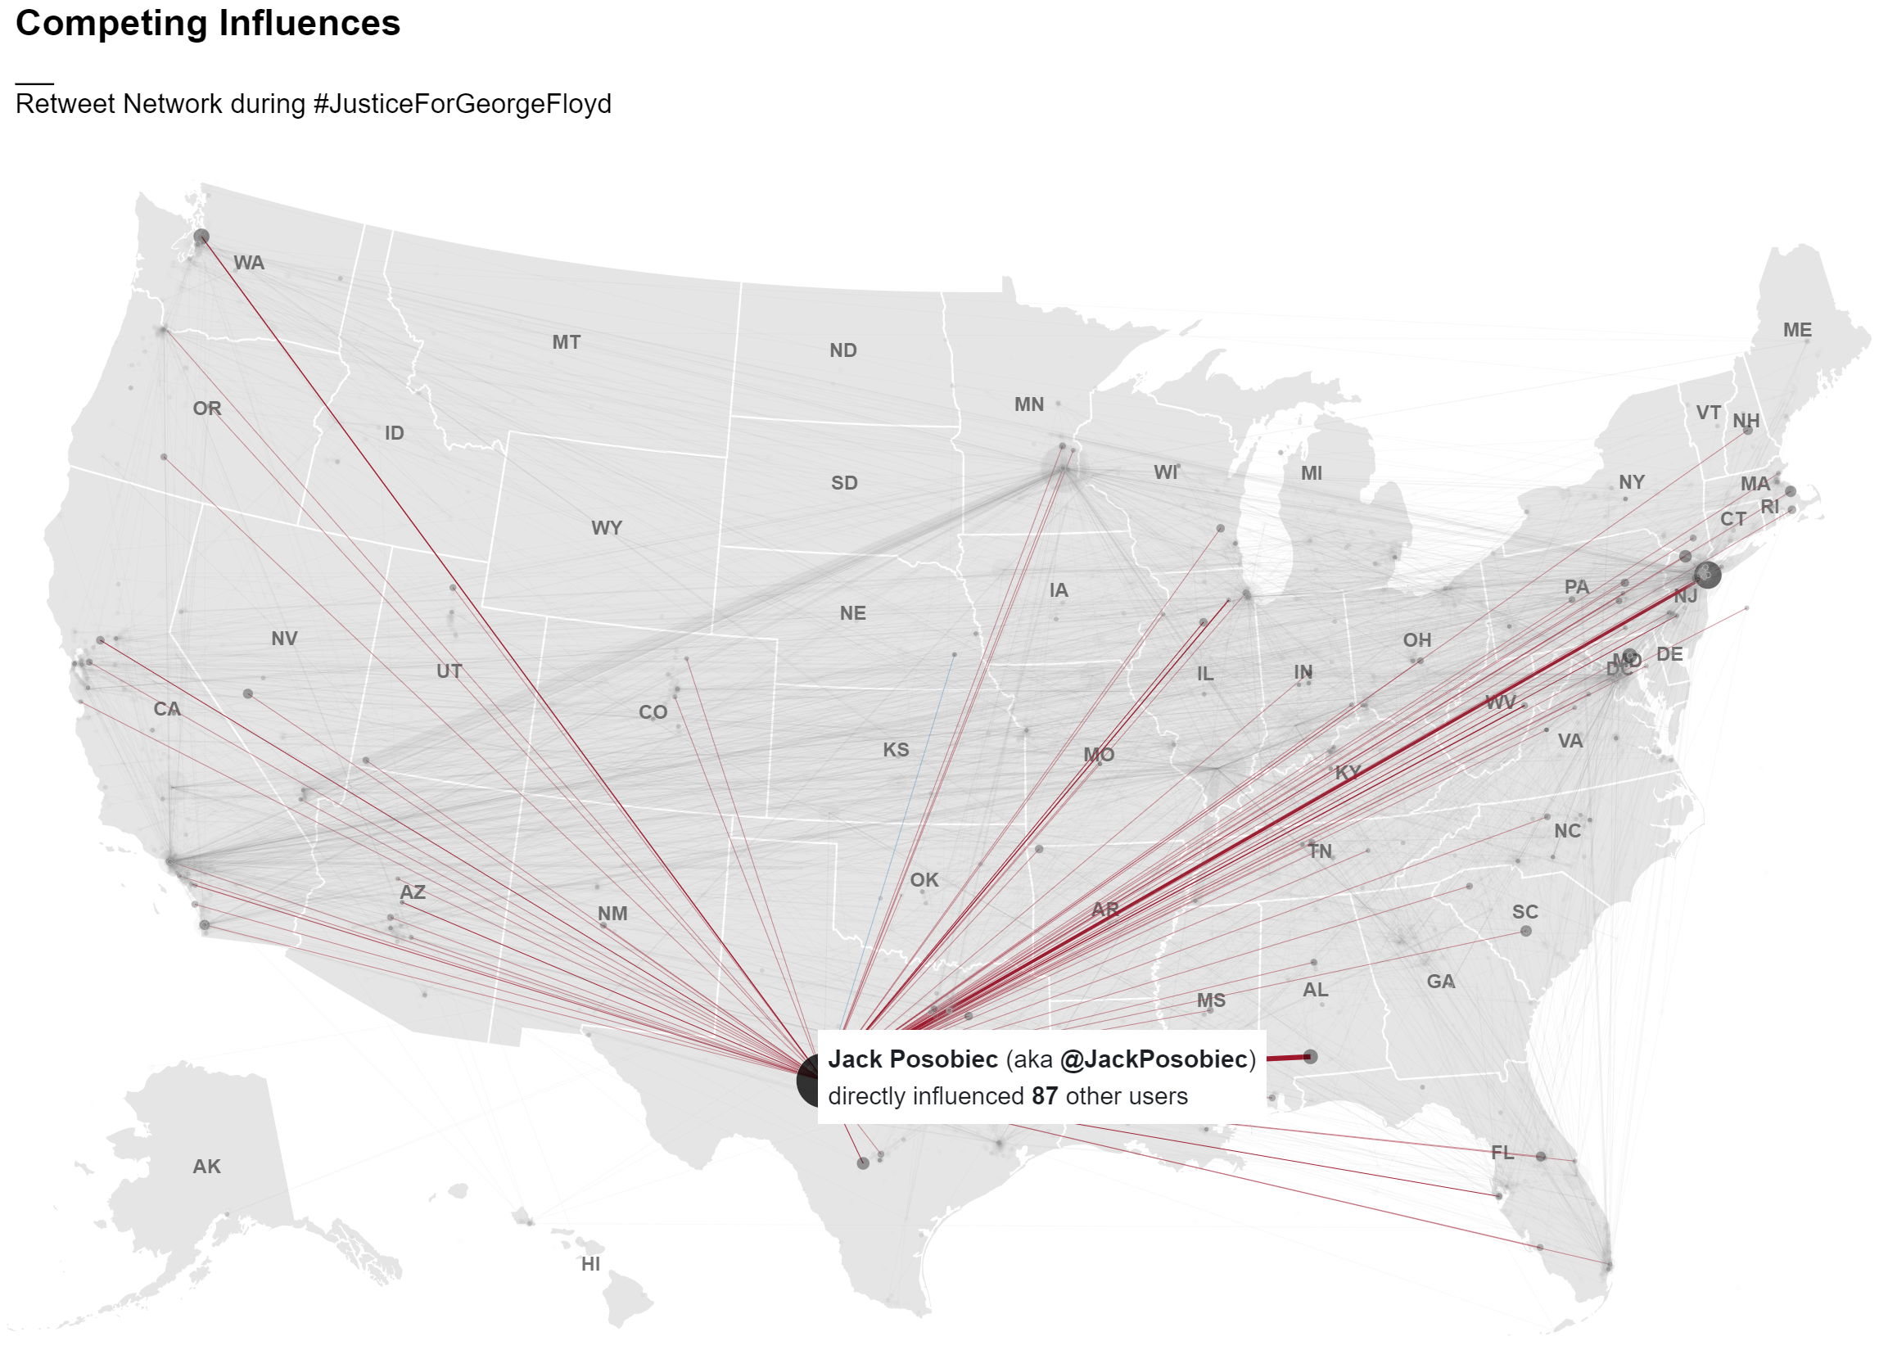

Slide 35
where we are now…
Most influential actors
Spatial distribution of social influence
…where we are going…
Temporal element (evolution of network over time?)
Leverage other network characteristics?
Repeat analysis with #JusticeForDaunteWright →
validation
model network structure?
Notes:
This is where I am at with this section of my thesis
Now I have some ideas of how to move forward:
Incorporate the temporal element in the network analysis
Leverage other net characteristics?
Repeat this analysis with the current socio political events happening as we speak

Slide 36
Questions
Feedback
Criticism
Fallacies
Advice
.
.
.
?

